Slide 1


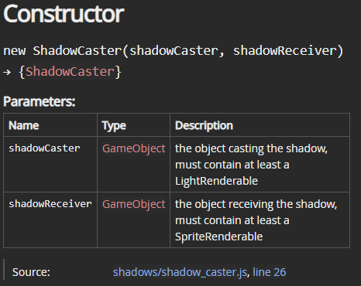
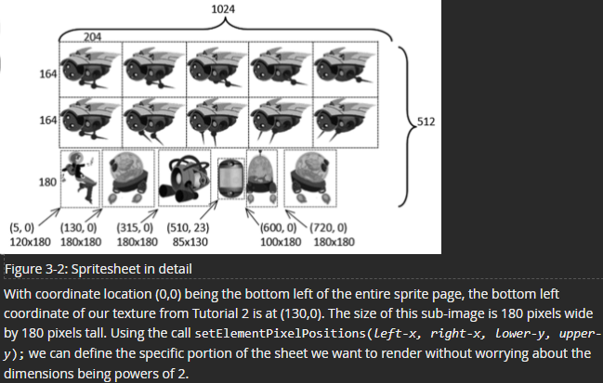




Game Engine Supporting Resources
Presenter: Myles Dalton Spring 2022 Advisor: Prof. Kelvin Sung
Overview
Methodology
I created documentation and tutorial webpages for the game engine by Prof. Sung
Game engine is an API for developing 2D web video games
Game engines provide ready-made solutions for common game features
Results
All developer-facing functions documented in source code
64 separate pages of interlinked API documentation
7 step-by-step tutorials on major engine features
Supporting materials that make the game engine more accessible
Motivation
Complicated API with several interconnected subsystems across 73 files
No quick or easy way to learn how to use the engine
Intended for students and beginner video game developers
Technologies
Snippet from ShadowCaster doc
Excerpt from Tutorial 3 on sprites

